Slide 1
Quick Analysis of NFL Draft Data using Arules & GGPLOT2 Package in R
Saad Yousef
(Twiter: SaadDataSci, GitHub: snyousef)
Job Seeker in Predictive Analytics, Data Analytics, Data Science

Slide 2
Description
Took all draft data from years 2014-2018 and pared data down to four attributes:
NFL Team (Arizona Cardinals, Dallas Cowboys, etc.)
NCAAF Team (Alabama, Texas, etc.)
NCAAF Team’s Conference (ACC, Big 12, etc.)
Player Position (WR, QB, etc.)

Slide 3
Objective
Look for patterns in team’s drafting habits. For example:
Do certain NFL teams draft more players from a school than any other school?
Do certain NFL teams draft more players from a conference than any other school?
Do certain NFL teams draft more players at one position than any other team?
Do players of a certain position come from one conference more than another?

Slide 4
Exploratory Data Analysis

Slide 5
Initial Observations
SEC (surprise) is conference with most people drafted (then came ACC, Big Ten, Pac-12, Big 12 in that order)
School with most draftees is…Alabama (surprise)
Position player most often picked was WR

Slide 6
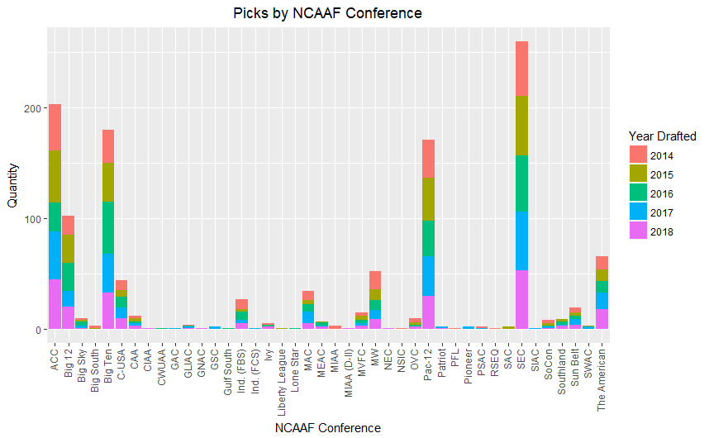
Picks from each NCAAF Conference

Slide 7
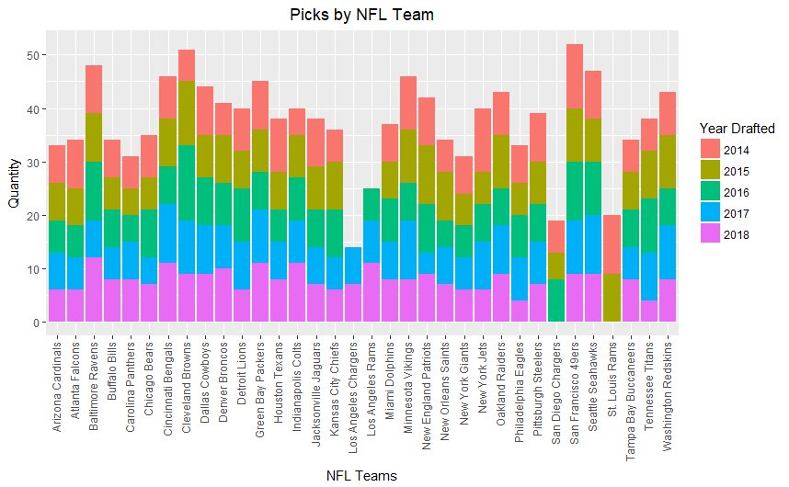
Picks per NFL Team

Slide 8
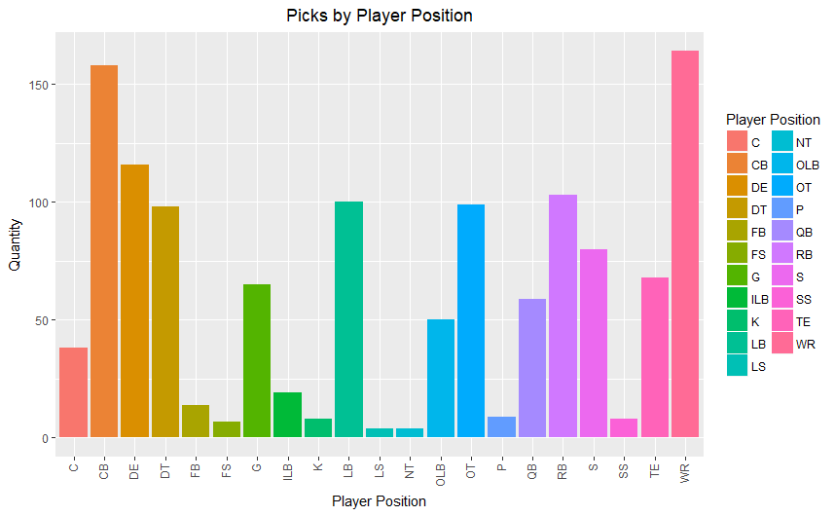
Picks by Player Position

Slide 9
Arules Package: What does it do?
CRAN Definition: Provides the infrastructure for representing, manipulating and analyzing transaction data and patterns (frequent item-sets and association rules).
More information about this package can be found on the CRAN website.
For this project: Find associations within draft data. Apriori algorithm finds rules (i.e.: if A happens, then B happens this often)

Slide 10
Terms to Know
Support: Number of times a particular item appears as a ratio to the entire number of items in dataset
Confidence: Ratio of a set of item(s) to only a portion of these items (i.e.: Confidence({A,B}→{C}) = support{A,B,C}/support{A,B})
How confident are we that C will be present given that A & B are present.
Lift: Likelihood that a set of items show up together, ‘A, B, & C,’ relative to the number of times ‘C’ will show up across all transactions (or in this case, draft selections).
Count: Number of times rule items show up together

Slide 11
Findings
Philadelphia Eagles and Carolina Panthers were likely to draft a CB
Green Bay Packers were likely to draft a WR
Buffalo Bills liked to draft from the ACC
Washington Redskins liked to draft from the SEC
All findings and code can be found at github.com/snyousef.

